Slide 1
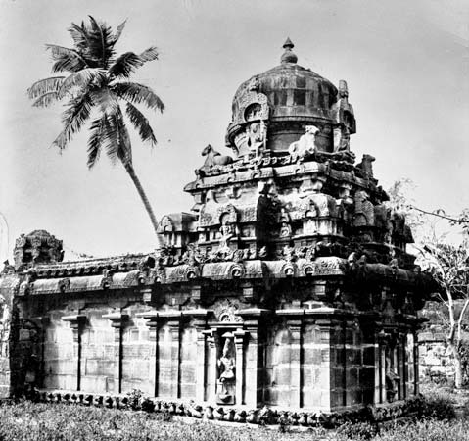
Temple Architecture

Slide 2
One important part of the ancient Indian temples was their decoration.
It is reflected in the multitude details of figured sculpture as well as in the architectural elements.
Another important component of Indian temples was the garbha-griha or the womb chamber, housing the deity of the temple.
The garbha-griha was provided with a circumambulation passage around.
In the initial stages of its evolution, the temples of North and South India were distinguished on the basis of some specific features like sikhara and gateways.
In the north Indian temples, the sikhara remained the most prominent component while the gateway was generally unassuming.

Slide 3
Design
The four essential and significant principles which are also aims of human life according to Indian philosophy are the quests for
(i) artha - wealth and prosperity;
(ii) kama - sex and pleasure;
(iii) dharma - moral life and virtues;
(iv) moksha - self knowledge and realisation
The Hindu temples suggest contemplations, encouragement and further purification of mind and prompt the process of self-realisation in devotees

Slide 4
Site
The areas of Hindu temple sites are usually vast with many of them built near water bodies, in the lap of nature
Leading Hindu temples are suggested near natural water bodies like confluence of rivers, river banks, seashores and lakes
Layout
Layout of a Hindu temple pursues a geometrical design known as vastu-purusha-mandala
The name of which is derived from the three vital components of the design namely Vastu meaning Vaas or a place of dwelling; Purusha, meaning the Universal principle; and Mandala meaning circle

Slide 5
Silapasastras refer to three major styles of temple architecture, Nagara, Dravida, and Vesara
Nagara style is associated with the land between the Himalayas and Vindhyas.
Dravida style with the land between the Krishna and Kaveri rivers
Vesara style is sometimes associated with the area between the Vindhyas and the Krishna river.

Slide 6
NAGARA STYLE :
The Nagara style has its origin in the structural temples of the Gupta period, especially the Dashavtara temple of Deogarh
The plan is square with a number of gradual projections in the middle of each side which Imparts it a cruciform shape.
In Nagara style temples, the structure consists of two buildings, the main shrine taller and an adjoining shorter mandapa.
The main difference between these two is the shape of the shikhara.

Slide 7
In the main shrine, abell shaped structure further adds to the height.
In this style, the temples mainly are formed of four chambers, first the ‘Garbhagriha’, then second Jagmohan’, third ‘Natyamandir’ and fourth chamber the ‘Bhogamandir’.
That the prototype of the North Indian temple already existed in the 6th century can be seen in surviving temples such as the temple at Deoghar, Bihar state, which has a small, stunted shikhara over the sanctuary.
Deoghar, also spelled Deogarh, city, northeastern Jharkhandstate, northeastern India. It is situated on the Ajay River in the Rajmahal Hills.

Slide 8
Vishnu temple, Deoghar, Jharkhand, India.
Frederick M. Asher

Slide 9
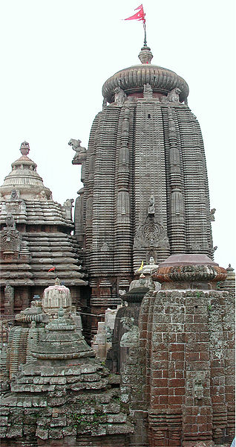
In the northern Nagara style, the shikhara takes the shape of a curvilinear beehive.
The temple is a square with a number of graduated projections in the middle of each side, giving a cruciform shape with a number of re-entrant angles on each side.
The projections in the plan are also carried upwards to the top of the shikhara, giving a strong emphasis on vertical lines in elevation .
Lingaraj Temple, Bhubaneshwar, Orissa:
The 11th century Lingaraj Temple is a fine example of the north Indian Nagara style of temple architecture, marked by its curvilinear, beehive-shaped shikhara.

Slide 10
Dravidian temple architecture evolved in South India predominantly comprise of temples built of sandstone, soapstone or granite.
The square-shaped temple called Vimana has one or more storied pyramidal roof while its cell houses the image or emblem of the God.
The Mandapas/Mandapams or porches are built in such a way that these precede and cover the door that leads to the cell.
The Gopurams/Gopuras or elaborate gateway-towers or gate-pyramids encloses the temples.
The Chaultris or pillared halls employed for different purposes forms one of the principal and constant features of this style.
Temple tanks, wells, abodes of priests and other important buildings form part of this temple style.
The famous Thanjavur temple of Tamil Nadu typifies this style.

Slide 12
VESARA STYLE :
It emerged during early medieval period.
It is a hybrid style that borrowed from the northern and southern styles. So, it is a mixture of both Nagara and Dravida styles of temple architecture.
Temples built in the Deccan under the later Chalukyas of Kalyani and Hoysalas are considered examples of this style.
Vesara style reduces the height of the temple towers even though the numbers of tiers are retained. This is accomplished by reducing the height of individual tiers.
The semi circular structures of the Buddhist chaityas are also borrowed in this style, as in the Durga temple of Aihole.
Many temples in Central India and Deccan have used the Vesara style with regional modifications.
The Papanatha temple (680 AD) in particular and someother temples to a lesser extent located at Pattadakal demonstrate panache for this stylistic overlap‛.

Slide 13
The trend of merging two styles was started by the Chalukyas of Badami (500-735 AD) who built temples in a style that was essentially a mixture of the Nagara and Dravida styles
Further refined by the Rashtrakutas of Manyakheta (750-983 AD) in Ellora, Chalukyas of Kalyani (983-1195 AD) in Lakkundi, Dambal, Gadag etc. and epitomized by the Hoysalas (1000-1330 AD).
Most of the temples built in Halebid, Belur and Somanathapura are classified under this style.

